Slide 1



Technology Trends Analysis
Manasi Khanolkar(29 January 2026)
© IBM Corporation. All rights reserved.

Slide 2



OUTLINE
Executive Summary
Introduction
Methodology
Results
  Visualization – Charts
  Dashboard
Discussion
  Findings & Implications
Conclusion

Slide 3

EXECUTIVE SUMMARY
Key Technology Trends: Python, SQL, and JavaScript dominate current programming usage, while MySQL, PostgreSQL, and Microsoft SQL Server lead database adoption.
Anticipated growth areas
  Python, Go, and TypeScript.
  PostgreSQL and MongoDB gaining traction.
Dashboard Insights: Most respondents are aged 18–34 with Bachelor’s or Master’s degrees, and cloud platforms (AWS, Azure, Google Cloud) are in high demand.
Strategic Implications: Focusing on Python, PostgreSQL, and scalable cloud platforms will align with both current usage and future developer preferences.

Slide 4

INTRODUCTION
This project analyzes global developer survey data to explore trends in programming languages, databases, cloud platforms, and developer demographics. Using interactive dashboards, the study highlights current technology usage, future preferences, and education levels across the developer community.
The objective is to provide a clear and data-driven view of technology adoption trends and developer distribution, enabling strategic insights for learners, educators, and organizations. These insights help identify in-demand skills, emerging technologies, and potential opportunities in the evolving tech landscape.

Slide 5

METHODOLOGY
Data Source: survey_data_updated.csv (developer survey responses).
Data Preparation:
Removed duplicates and missing values.
Split multi-value fields (e.g., LanguageHaveWorkedWith) into separate rows for accurate counting. Tools Used:
Excel → Data cleaning and wrangling.
IBM Cognos Analytics → Building dashboards and visualizations. Dashboard Design:
Created 3 tabs → Current Technology Usage, Future Technology Trends, and Demographics.
Applied appropriate chart types (bar, column, word cloud, treemap, pie, stacked bar, line, map, bubble).

Slide 6
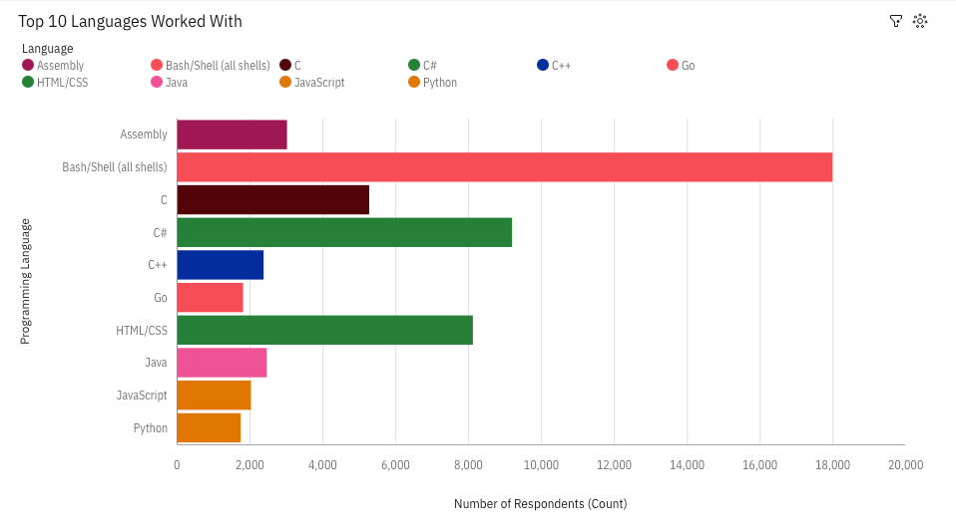
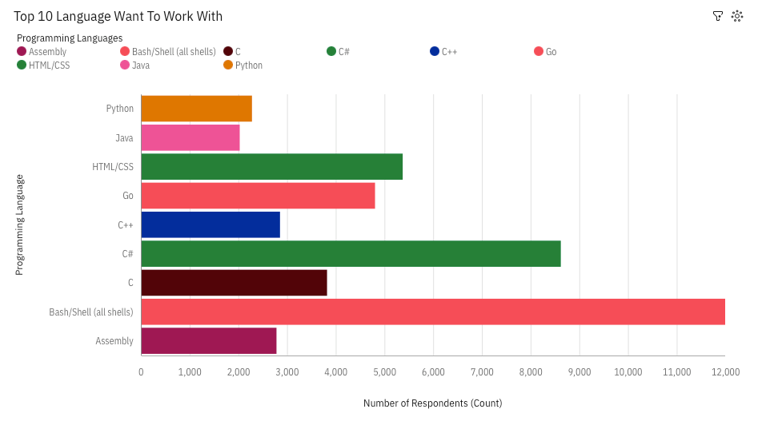
PROGRAMMING LANGUAGE TRENDS
Current Year
Next Year

Slide 7
PROGRAMMING LANGUAGE TRENDS - FINDINGS & IMPLICATIONS
Findings
Implications
Bash/Shell, C#, and Html/CSS are the most commonly used languages among developers.
Intrust to learn increases for each Language but Future interest shifts more toward Go, C++ and C# — showing demand for modern, versatile languages.
Traditional languages (Bash/Shell, Html/CSS) remain steady but are less preferred by newer developers.
Where as Python and java shows slightly more demand in future.
Companies should continue to invest in C# talent since it shows both strong current use and growing future interest.
Go and C++ are rising in demand, so organizations should prepare training and projects that adopt these modern, versatile languages.
As Bash/Shell and HTML/CSS remain steady but less desired by newer developers, teams may use them for legacy systems but shift focus toward scalable languages for future development.
Education providers should emphasize C#, Go, and C++ and even python and Java in learning paths to align with industry needs.

Slide 8
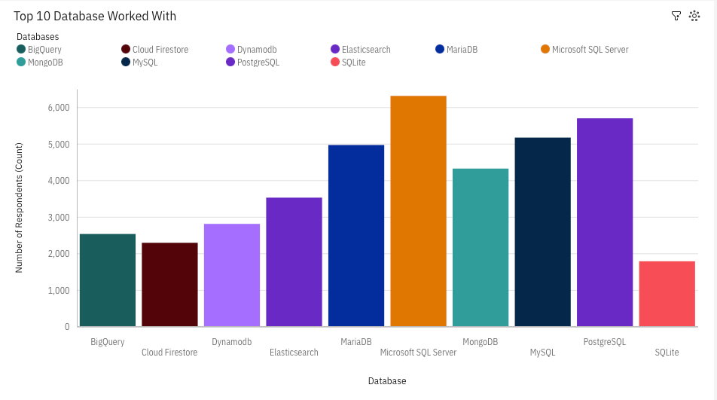
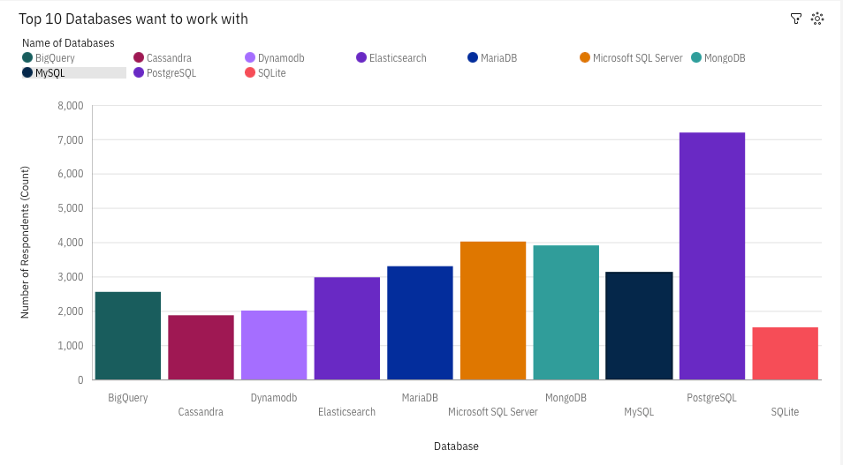
DATABASE TRENDS
Current Year
Next Year

Slide 9
DATABASE TRENDS - FINDINGS & IMPLICATIONS
Findings
Implications
Microsoft SQL Server is the most widely used database, showing strong industry adoption and reliability.
Companies can continue leveraging Microsoft SQL Server for its reliability, but should also plan for modernization as newer developers shift preferences.
PostgreSQL is gaining popularity with developers, reflecting its flexibility and advanced features.
PostgreSQL’s rise signals the need for organizations to invest in PostgreSQL talent and migration strategies for scalable, flexible systems.
MongoDB is also highly preferred among non-relational databases, especially for modern web apps.
MongoDB’s popularity in non-relational use cases highlights the importance of NoSQL adoption for businesses focusing on big data and web applications.
Future interest shifts more toward PostgreSQL while older databases (e.g., Microsoft SQL Server, Oracle) show stable but slower growth.
MySQL’s steady rank (3rd place) shows it remains a practical and cost-effective option, especially for startups and smaller projects.
MySQL is 3rd most used Database.
Businesses heavily dependent on legacy databases like Oracle may face talent shortages and should balance legacy maintenance with gradual transition to modern platforms.

Slide 10
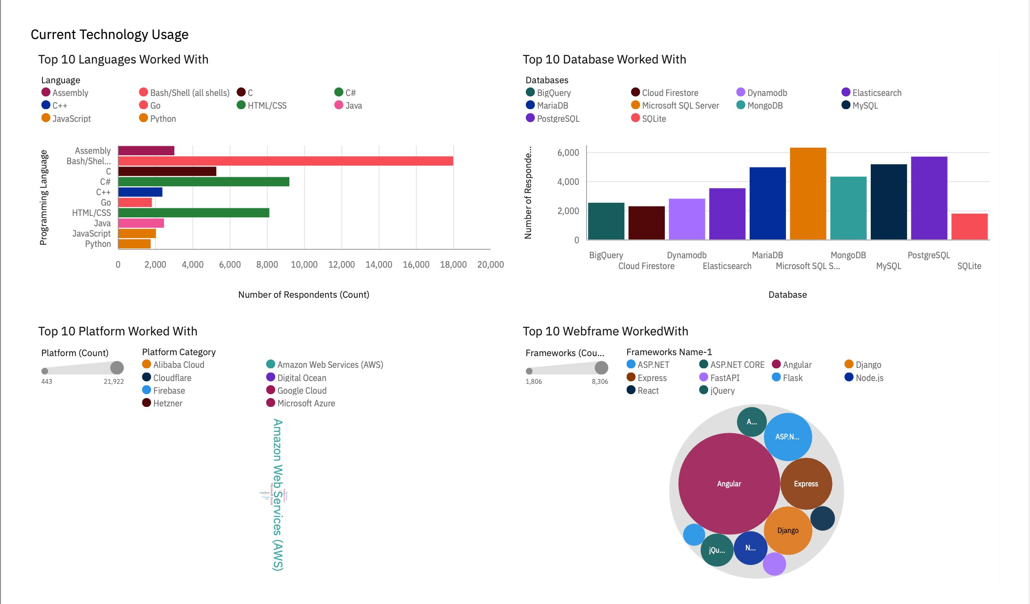
Dashboard : Current Technology Usage

Slide 11
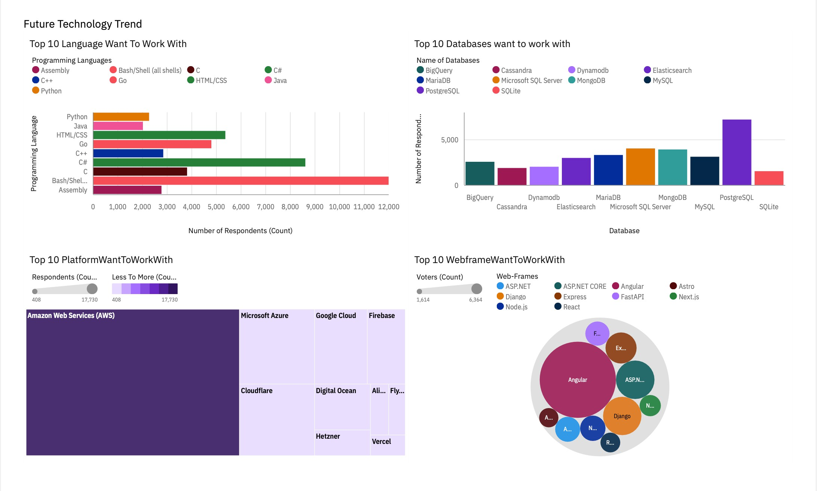
Dashboard : Future Technology Usage

Slide 12
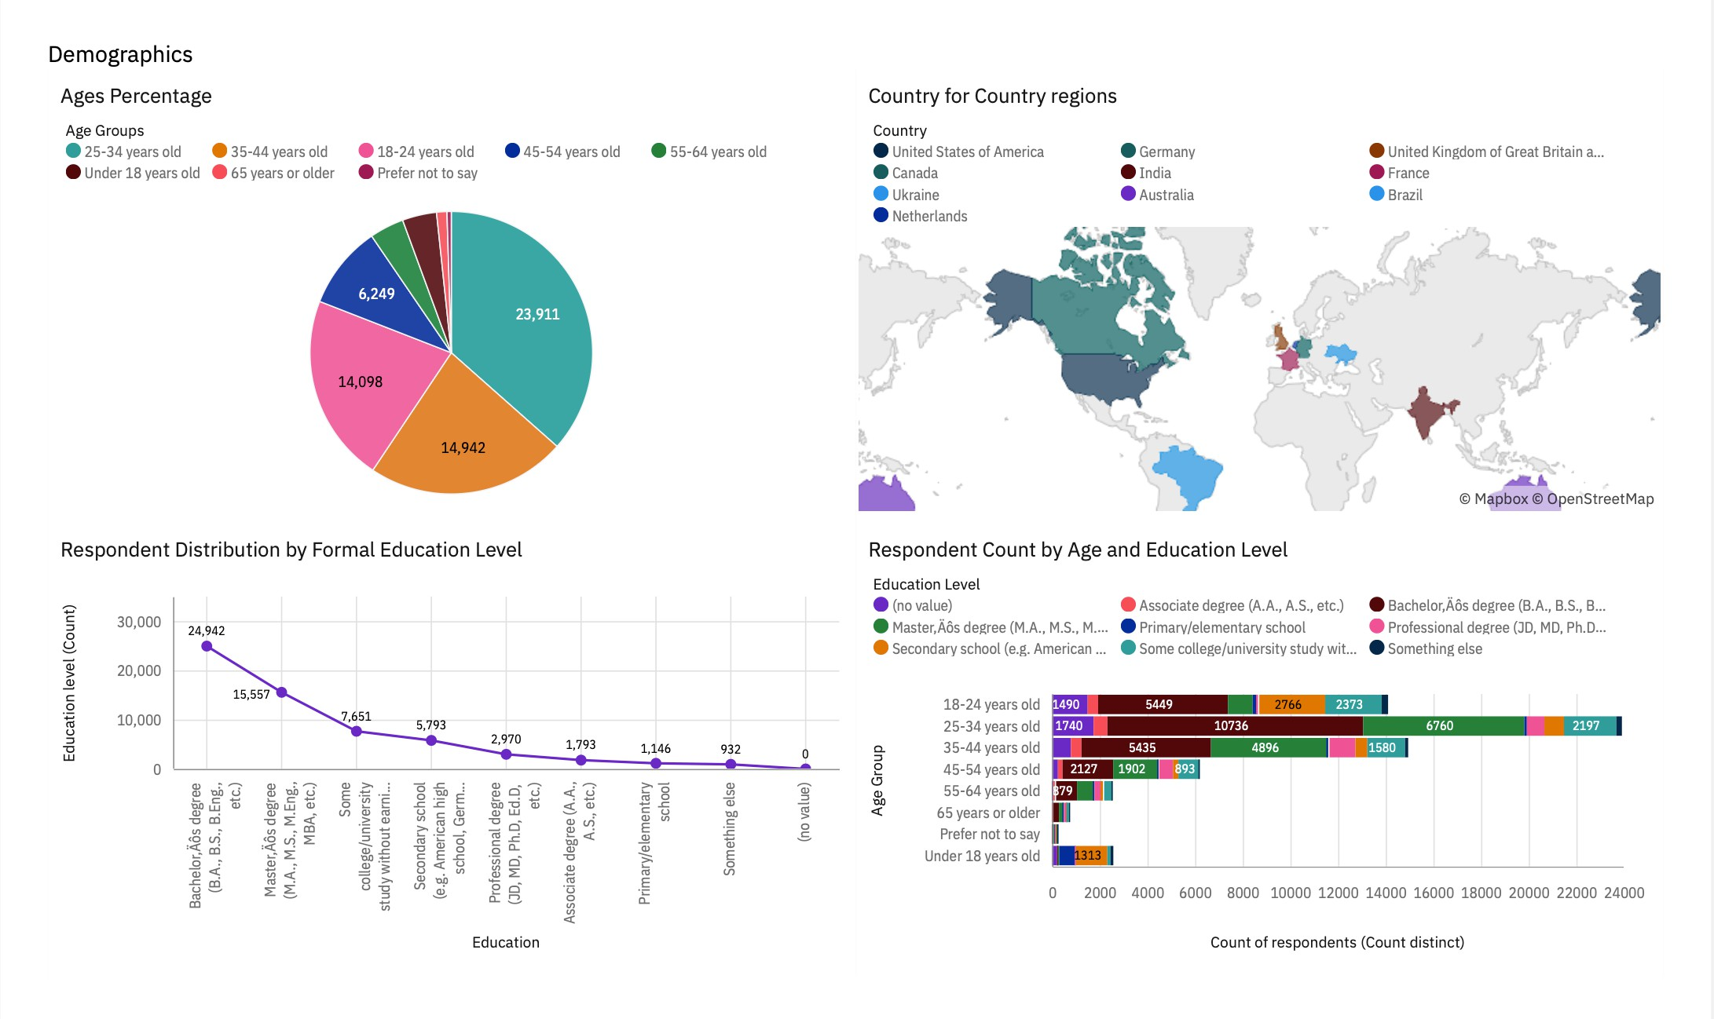
Dashboard : Demographics

Slide 13

KEY TAKEAWAYS
Programming Languages: Bash/Shell, C#, and HTML/CSS lead in current usage, while future demand is shifting toward Go, C++, and C#.
Databases: Microsoft SQL Server is the most widely used today; PostgreSQL shows strong growth in future preference, and MongoDB remains the top non-relational database.
Developer Demographics: Respondents span diverse age groups and education levels, with developers aged 20–35 showing greater interest in emerging languages and modern databases.
Technology Trends: Clear shift from traditional technologies toward modern, scalable, and versatile solutions such as Go, PostgreSQL, and MongoDB.
Education Levels: Developers with Master’s/PhD degrees show stronger interest in specialized modern tools (Go, PostgreSQL), while undergraduates and diploma holders prefer widely used and accessible technologies like HTML/CSS and MySQL.

Slide 14
OVERALL FINDINGS & IMPLICATIONS
Findings
Implications
Programming Languages: The shift in interest toward Go, C++, and C# indicates that organizations may need to expand their tech stack to attract and retain new developer talent.
Programming Languages: Bash/Shell, HTML/CSS, and C# are the most widely used, but interest is shifting toward Go, C++, and C#.
Databases: Microsoft SQL Server dominates current usage, while PostgreSQL and MongoDB are gaining popularity.
Databases: The rise of PostgreSQL and MongoDB highlights a growing preference for flexible, scalable, and modern data solutions over older enterprise-heavy options.
Trends: Traditional languages/databases remain steady but show slower growth compared to modern, flexible options.
Trends: Slower growth of traditional languages/databases suggests that companies relying only on legacy systems risk falling behind as developer communities focus on newer tools.
Demographics: Younger and higher-educated developers are more likely to adopt modern technologies.
Demographics: Younger, highly educated developers are driving modern tech adoption, meaning businesses must align their hiring and training strategies with these preferences to stay competitive.
Platform worked with remains same in future with slower growth whereas Webframe ASP. NET Core demand increase rapidly.
Platforms & Frameworks: Since platform usage remains steady, innovation will primarily come from framework adoption. The rapid demand for ASP.NET Core suggests businesses should prioritize modern frameworks to build future-ready applications.

Slide 15

CONCLUSION
Modern shift in technology adoption – While traditional languages and databases like Bash/Shell, HTML/CSS, and SQL Server dominate current usage, future trends clearly show a pivot toward modern, flexible tools such as Go, PostgreSQL, and ASP.NET Core.
Developer preferences drive industry change – Younger, better-educated developers are reshaping the technology landscape, pushing organizations to adopt versatile languages, scalable databases, and newer frameworks to remain attractive and competitive.
Balance of stability and innovation – Legacy technologies remain important for reliability and enterprise systems, but the long-term advantage lies in strategically blending them with emerging tools to support both stability and future growth.

